Slide 1

Name : Aftab Alam
Roll Number: 2110990103 Group No. : 28
Project : A3_Schools (CMS)

Slide 2
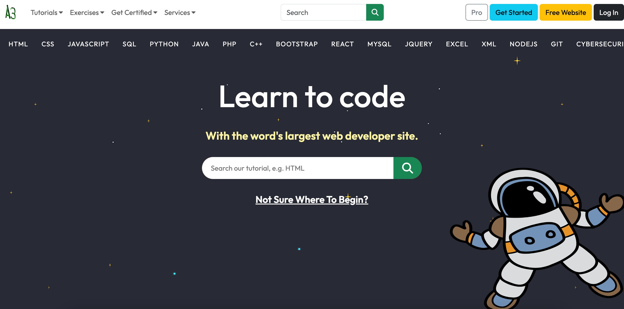
Project Description:
I have made a Content Management System which offers tutorials in numerous programming languages, spanning from introductory lessons for beginners to advanced topics. Whether you're interested in Python, Java, JavaScript, C++,Html, Css ,React , Artificial Intelligence or any other language, you'll find a wealth of resources readily available.
******************** Home Page or Landing Page*******************
The Top Navbar menu I have made using the React Bootstrap which includes a logo of my website and 4 dropdown
Items -Tutorials, Exercises, Get Certified and Services and a Search field and then 4 buttons
import { Navbar, Nav, Button, FormControl, Form } from ‘react- bootstrap';

Slide 3
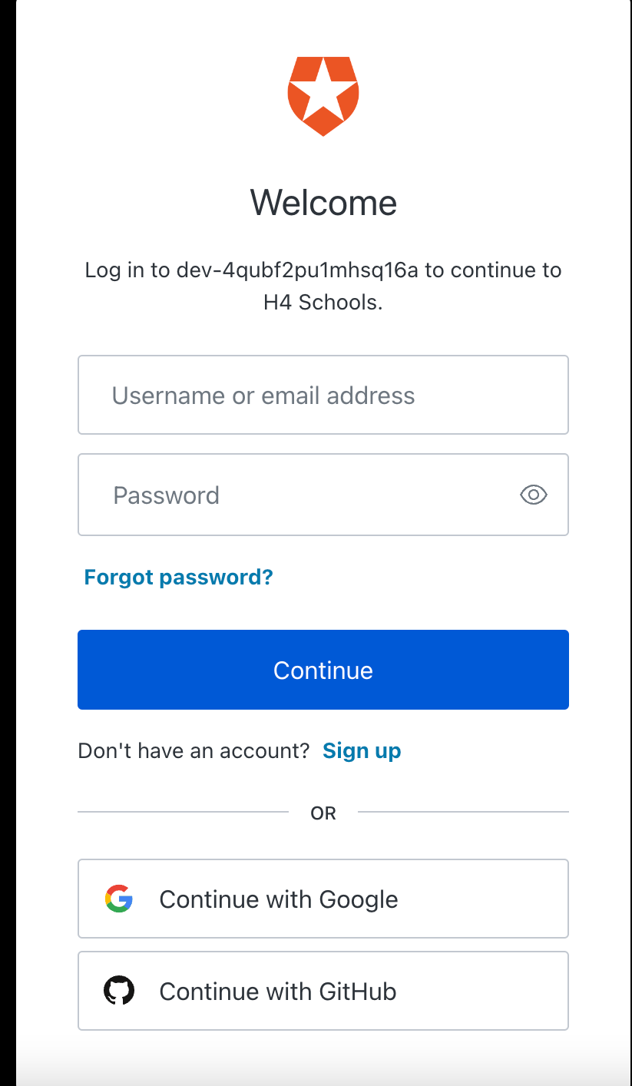
I have also made the Login functionality using the auto0 Tool provided by the Google .
Auto0: Auth0 is a flexible, drop-in solution to add authentication and authorization services to your applications.
On clicking on the Log In button you be redirected to a page where you can fill up your details and get login to the website or you can simply Sign up using Google or Github if you don’t have any account
and after you have done with the login or sign up process you will be having your profile setup and now if you want to be log out you can simple log out on clicking on logout

Slide 4
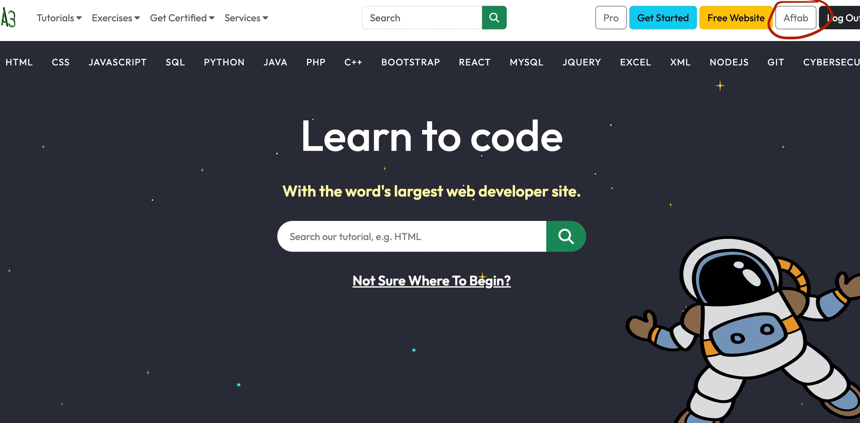


Slide 5
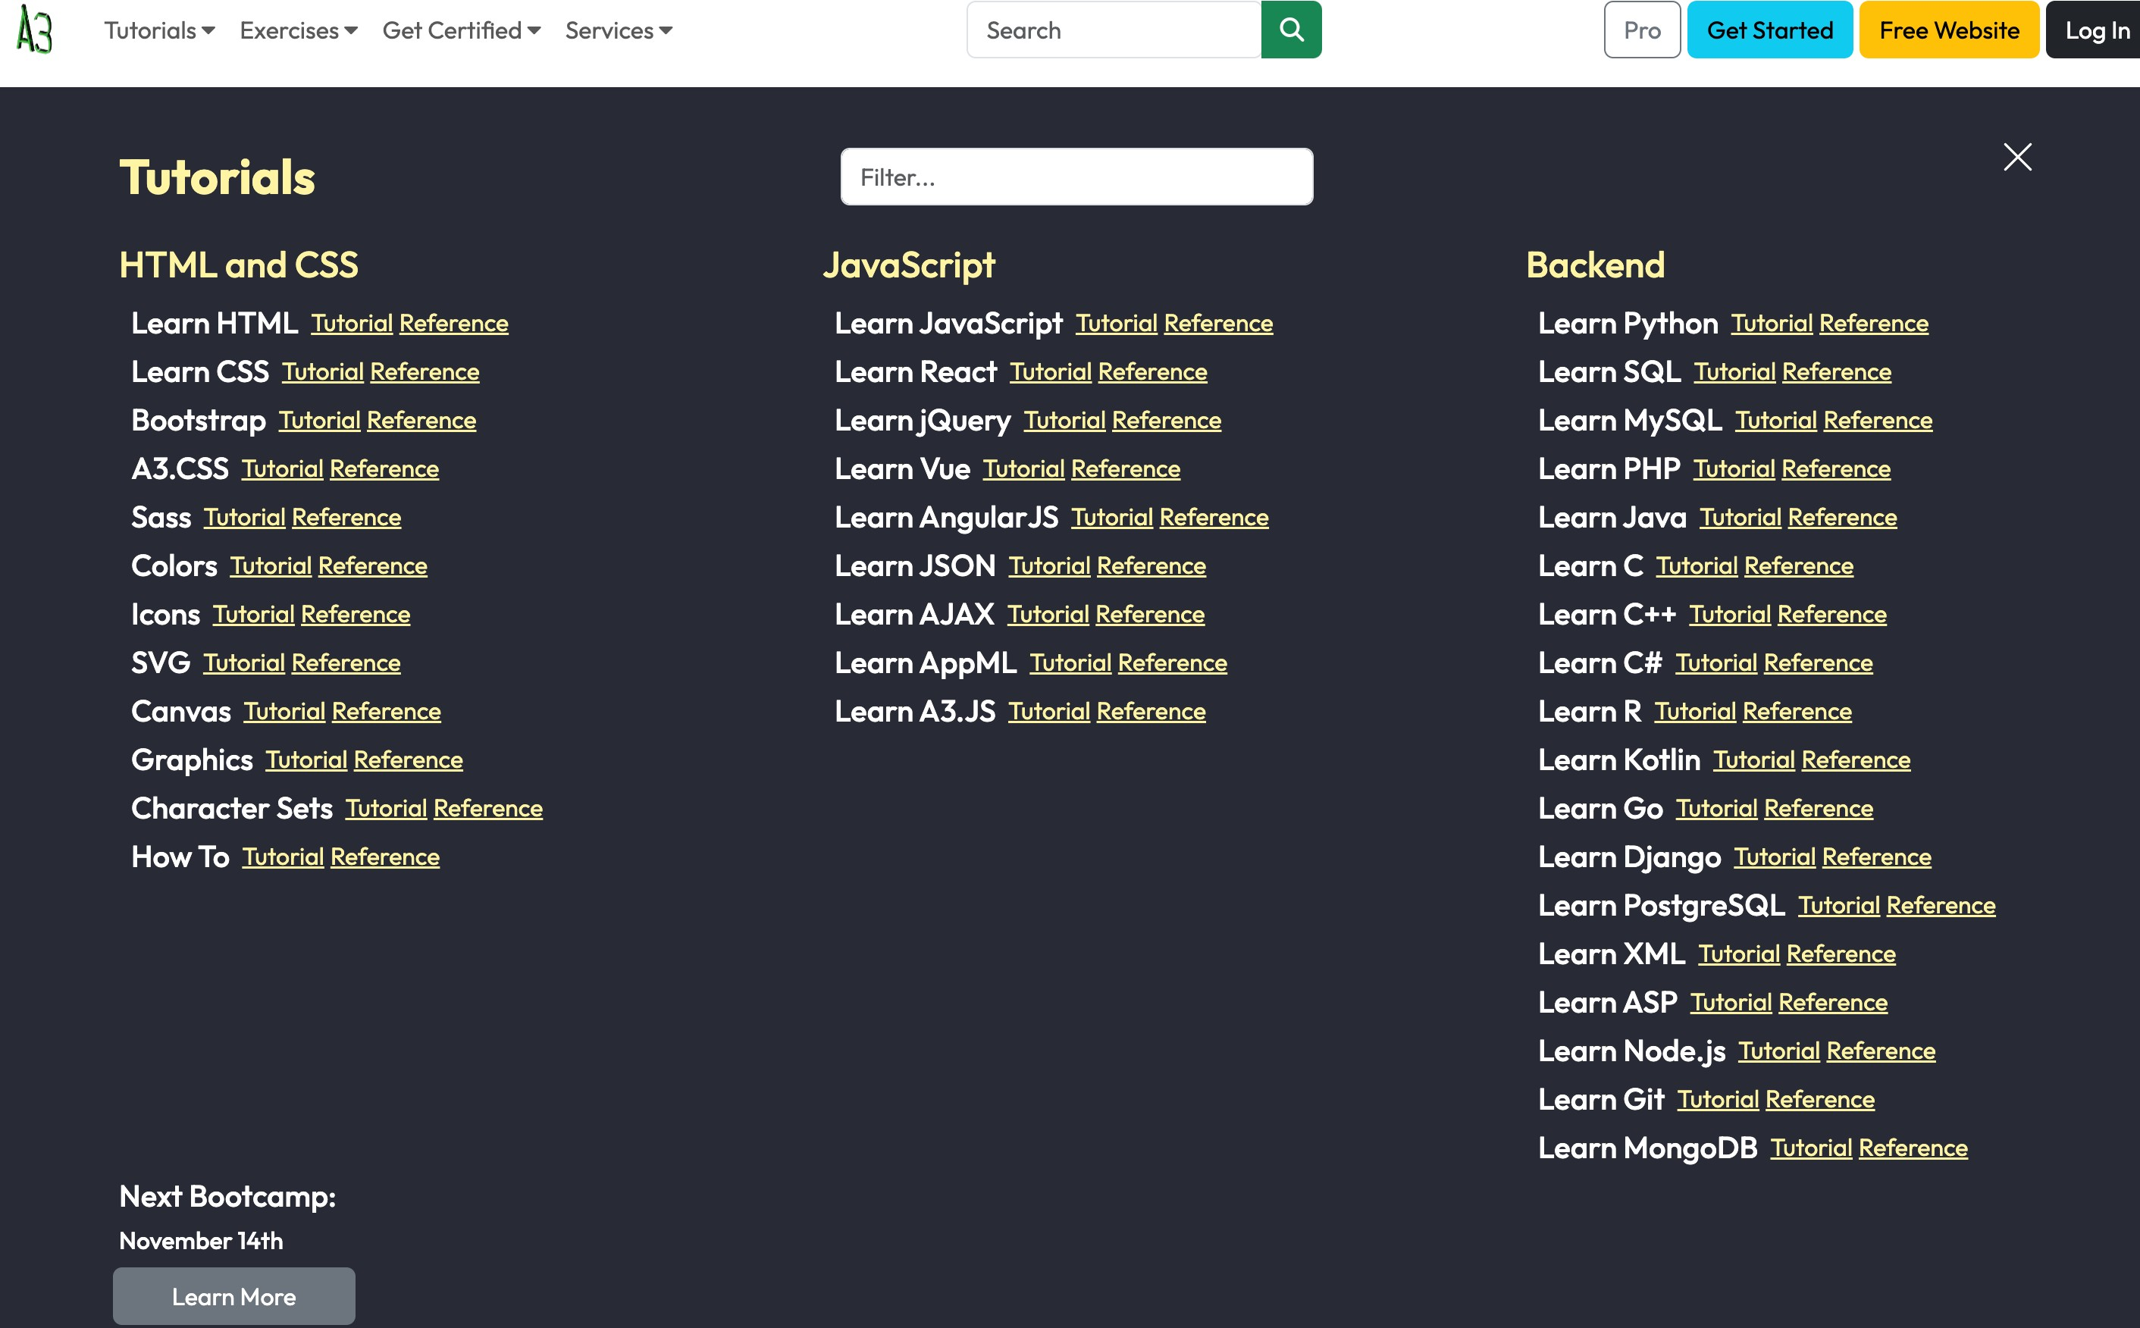
*************************Tutorials*******************************
On clicking On tutorials, this pages appears which have links to all the tutorials of this website . This page is made using React Bootstrap Grid Container .
Also you can search the tutorial you are interested in using the filter functionality which I have made using the UseState Hook .
I have rendered the content of the page using the Objects .
The same layout is followed in the Excerises , Get Certified and Services Page

Slide 6
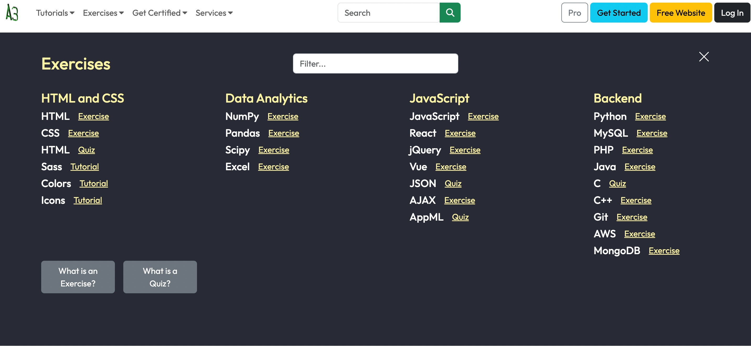
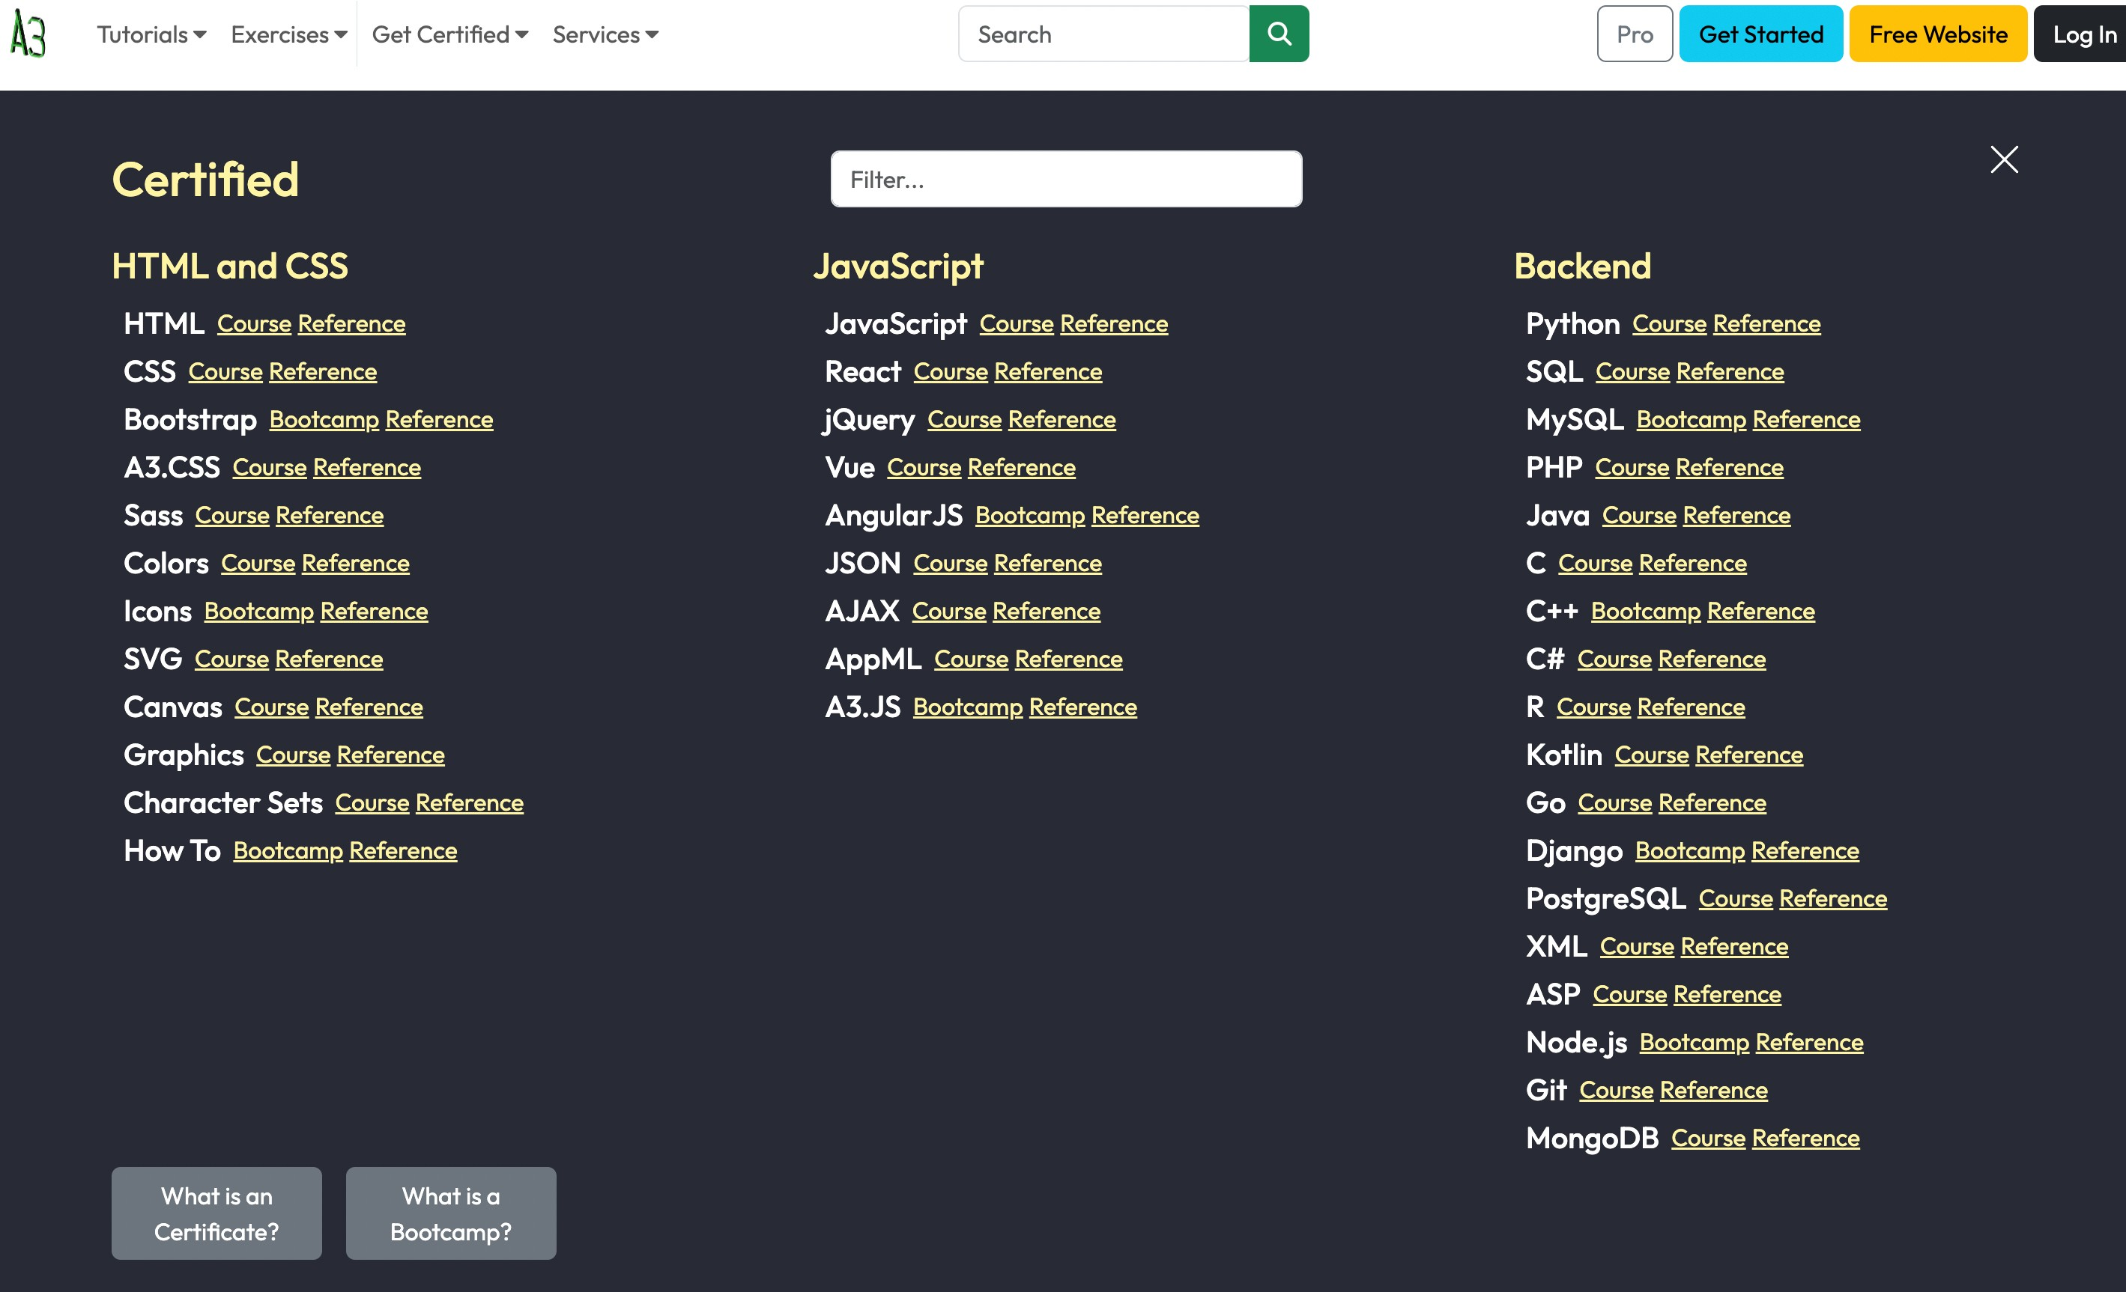
***********************************Excercises**************************************
***************************Get Certified***************************

Slide 7
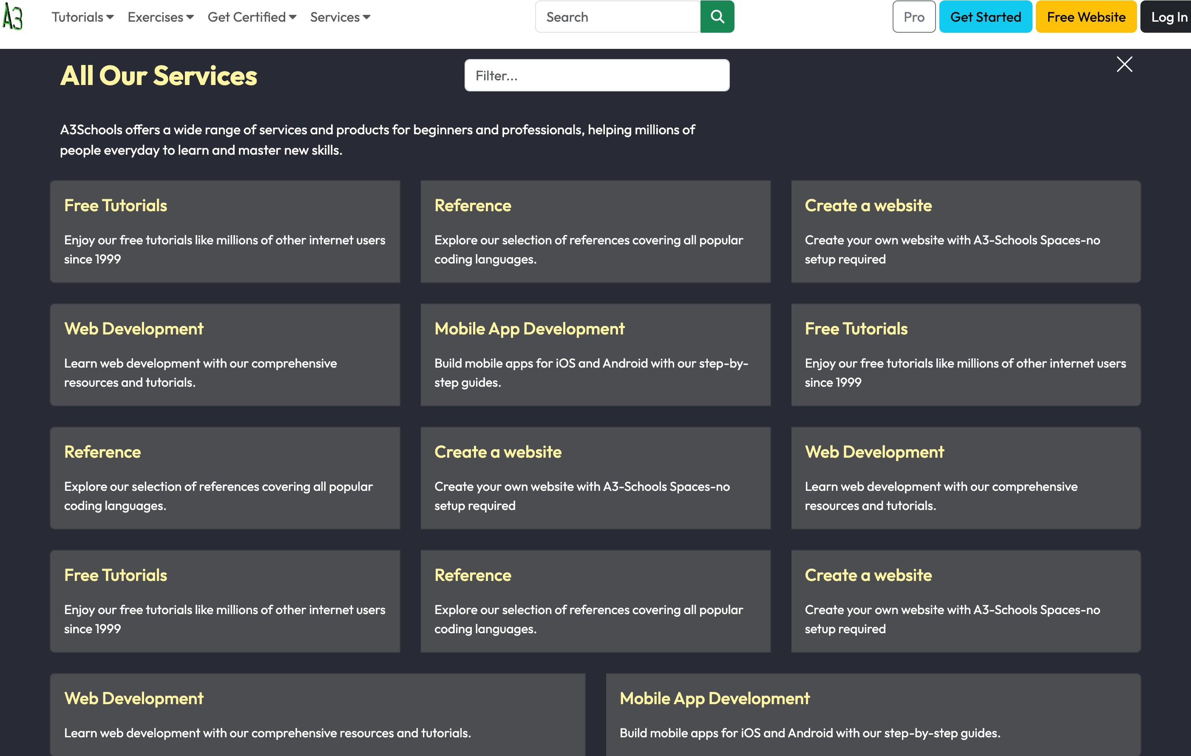
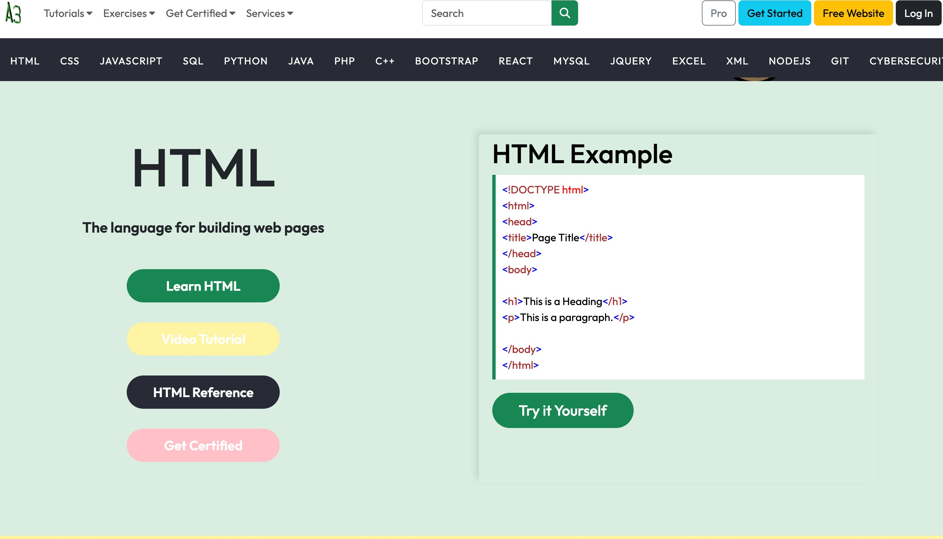
**************************Services******************************
There are various section on the home page containing direct link to the tutorials of various languages .

Slide 8
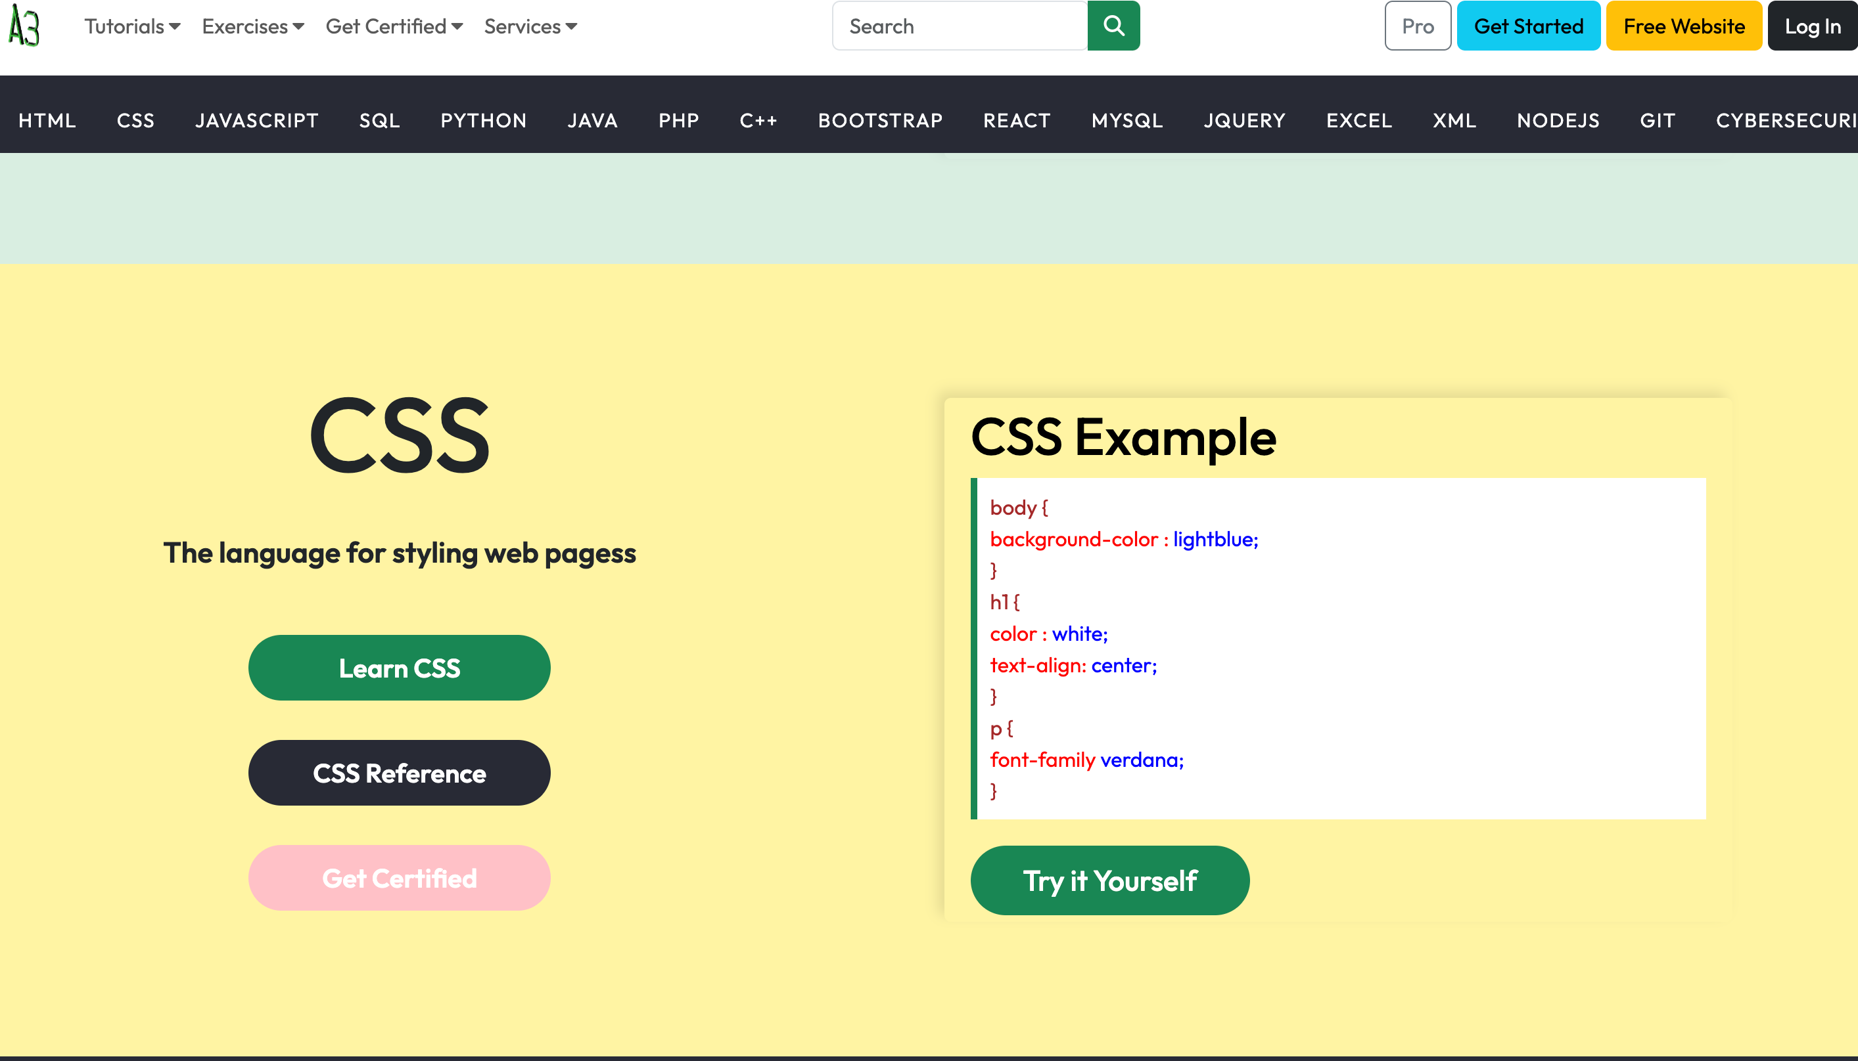
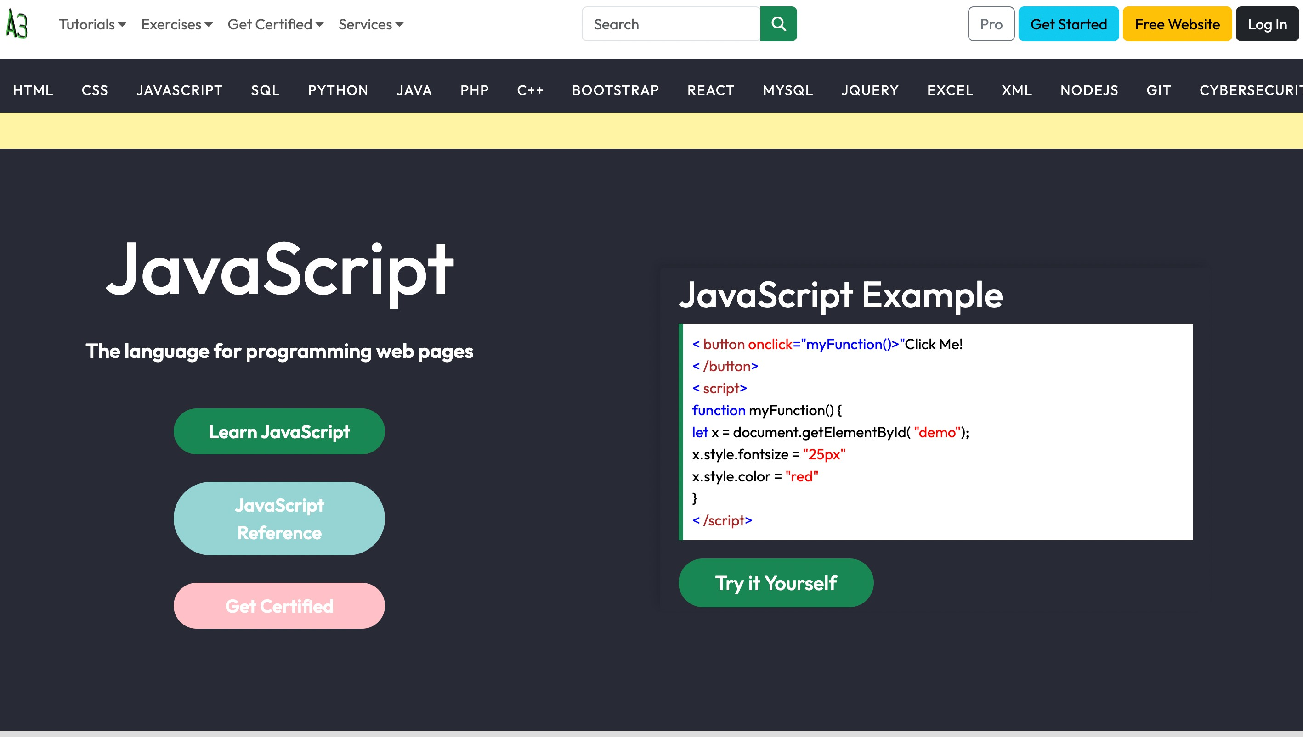

Slide 9
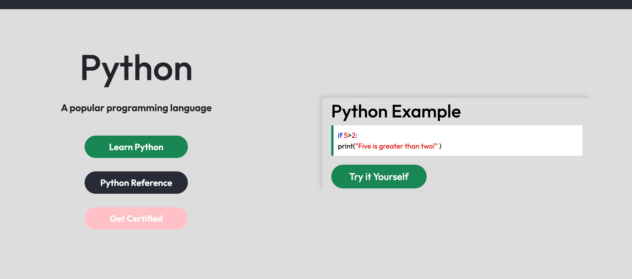
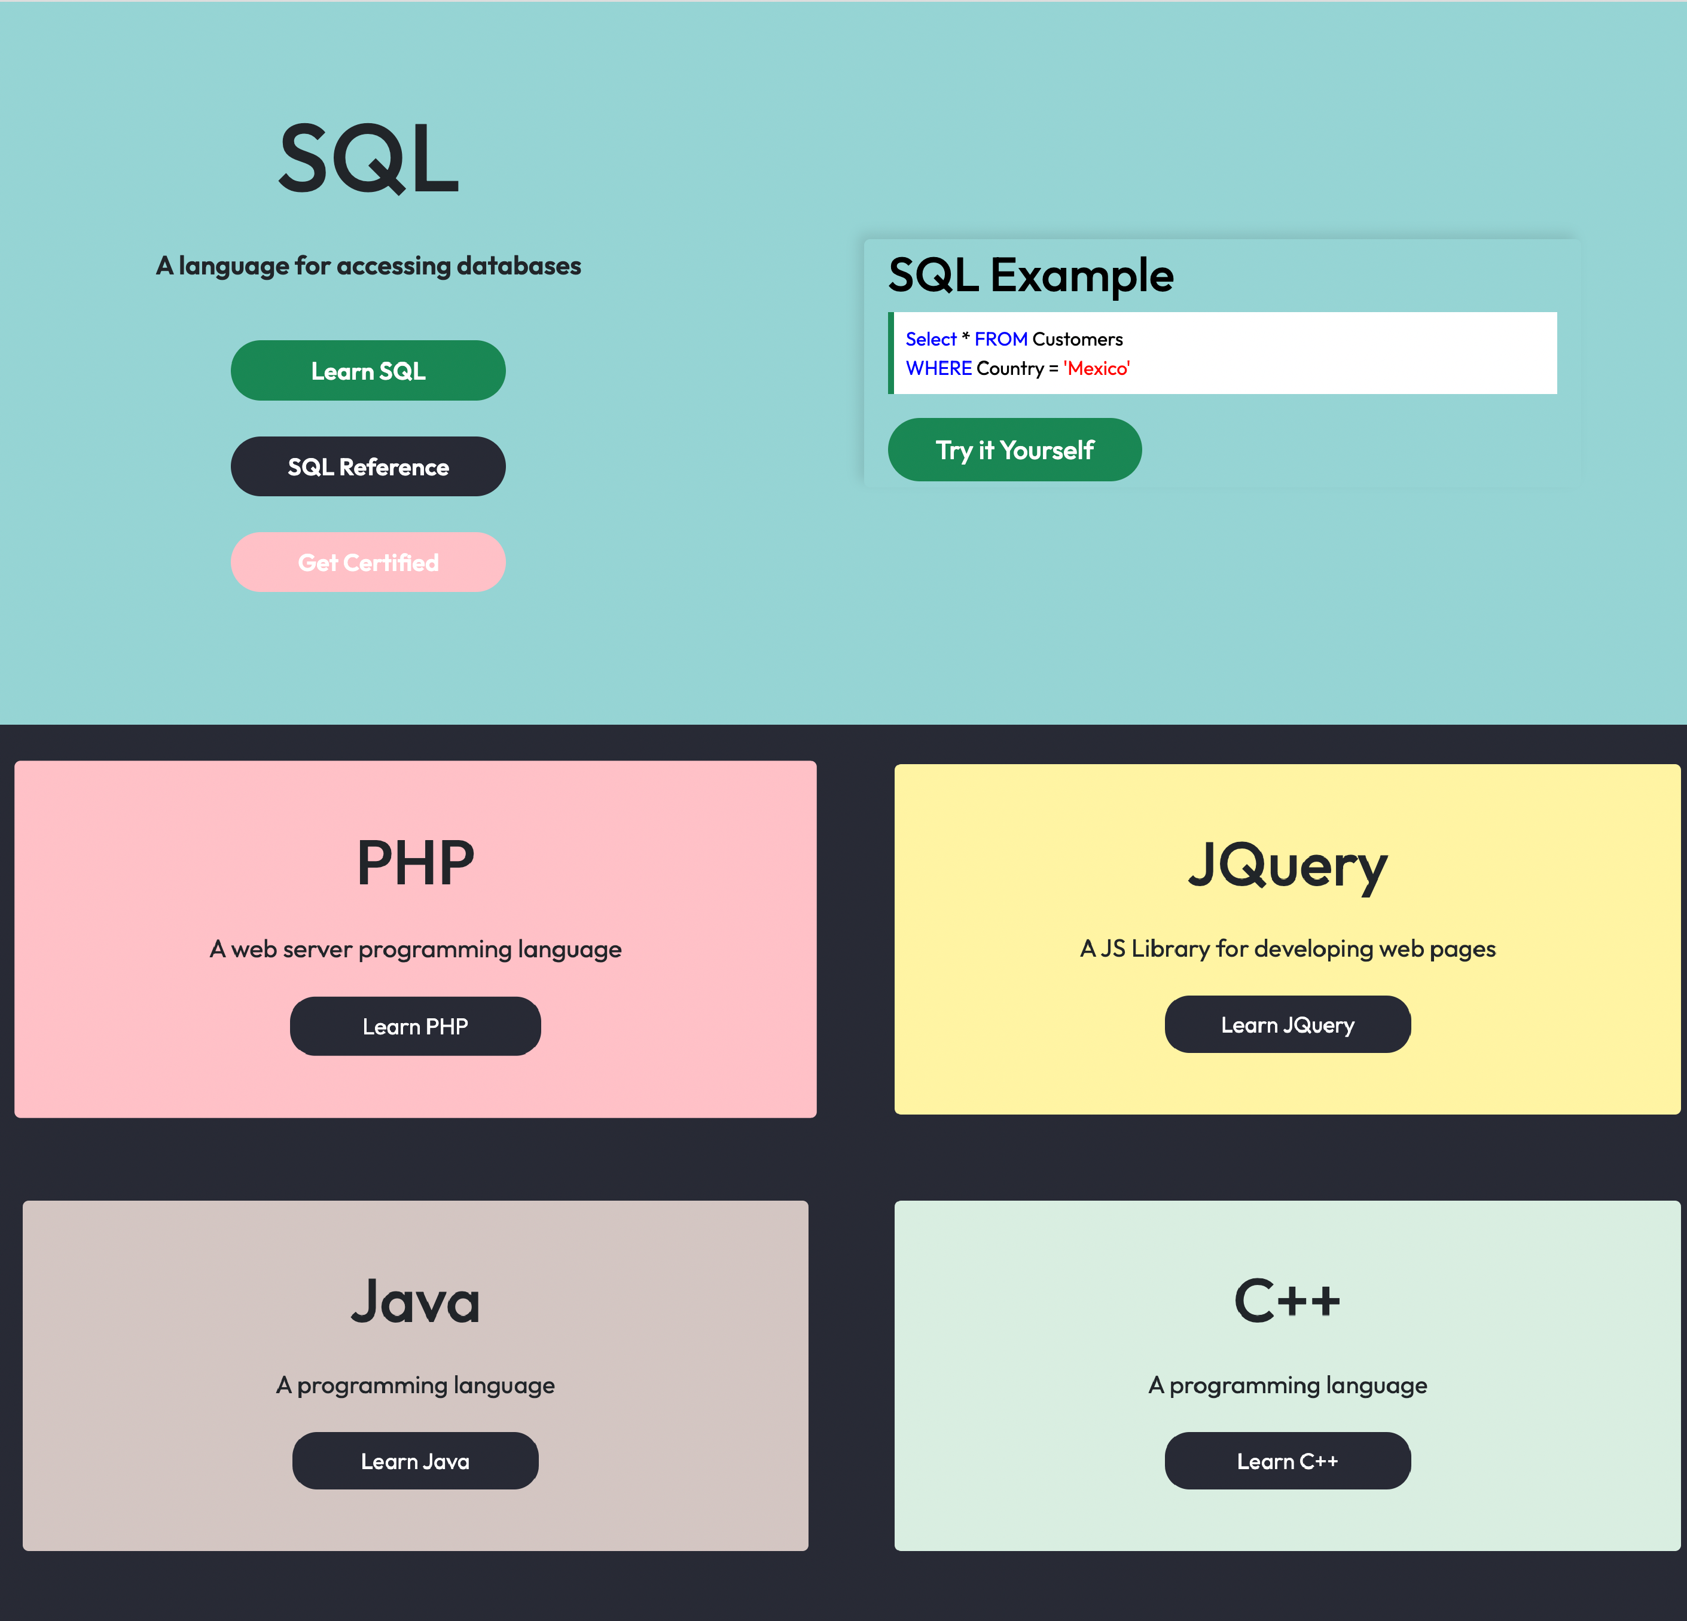

Slide 10
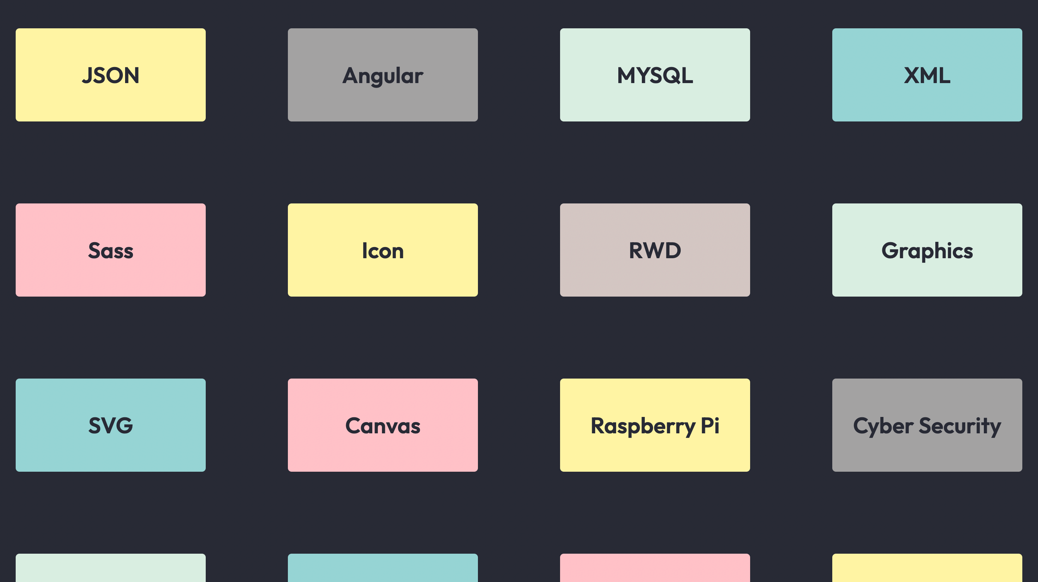
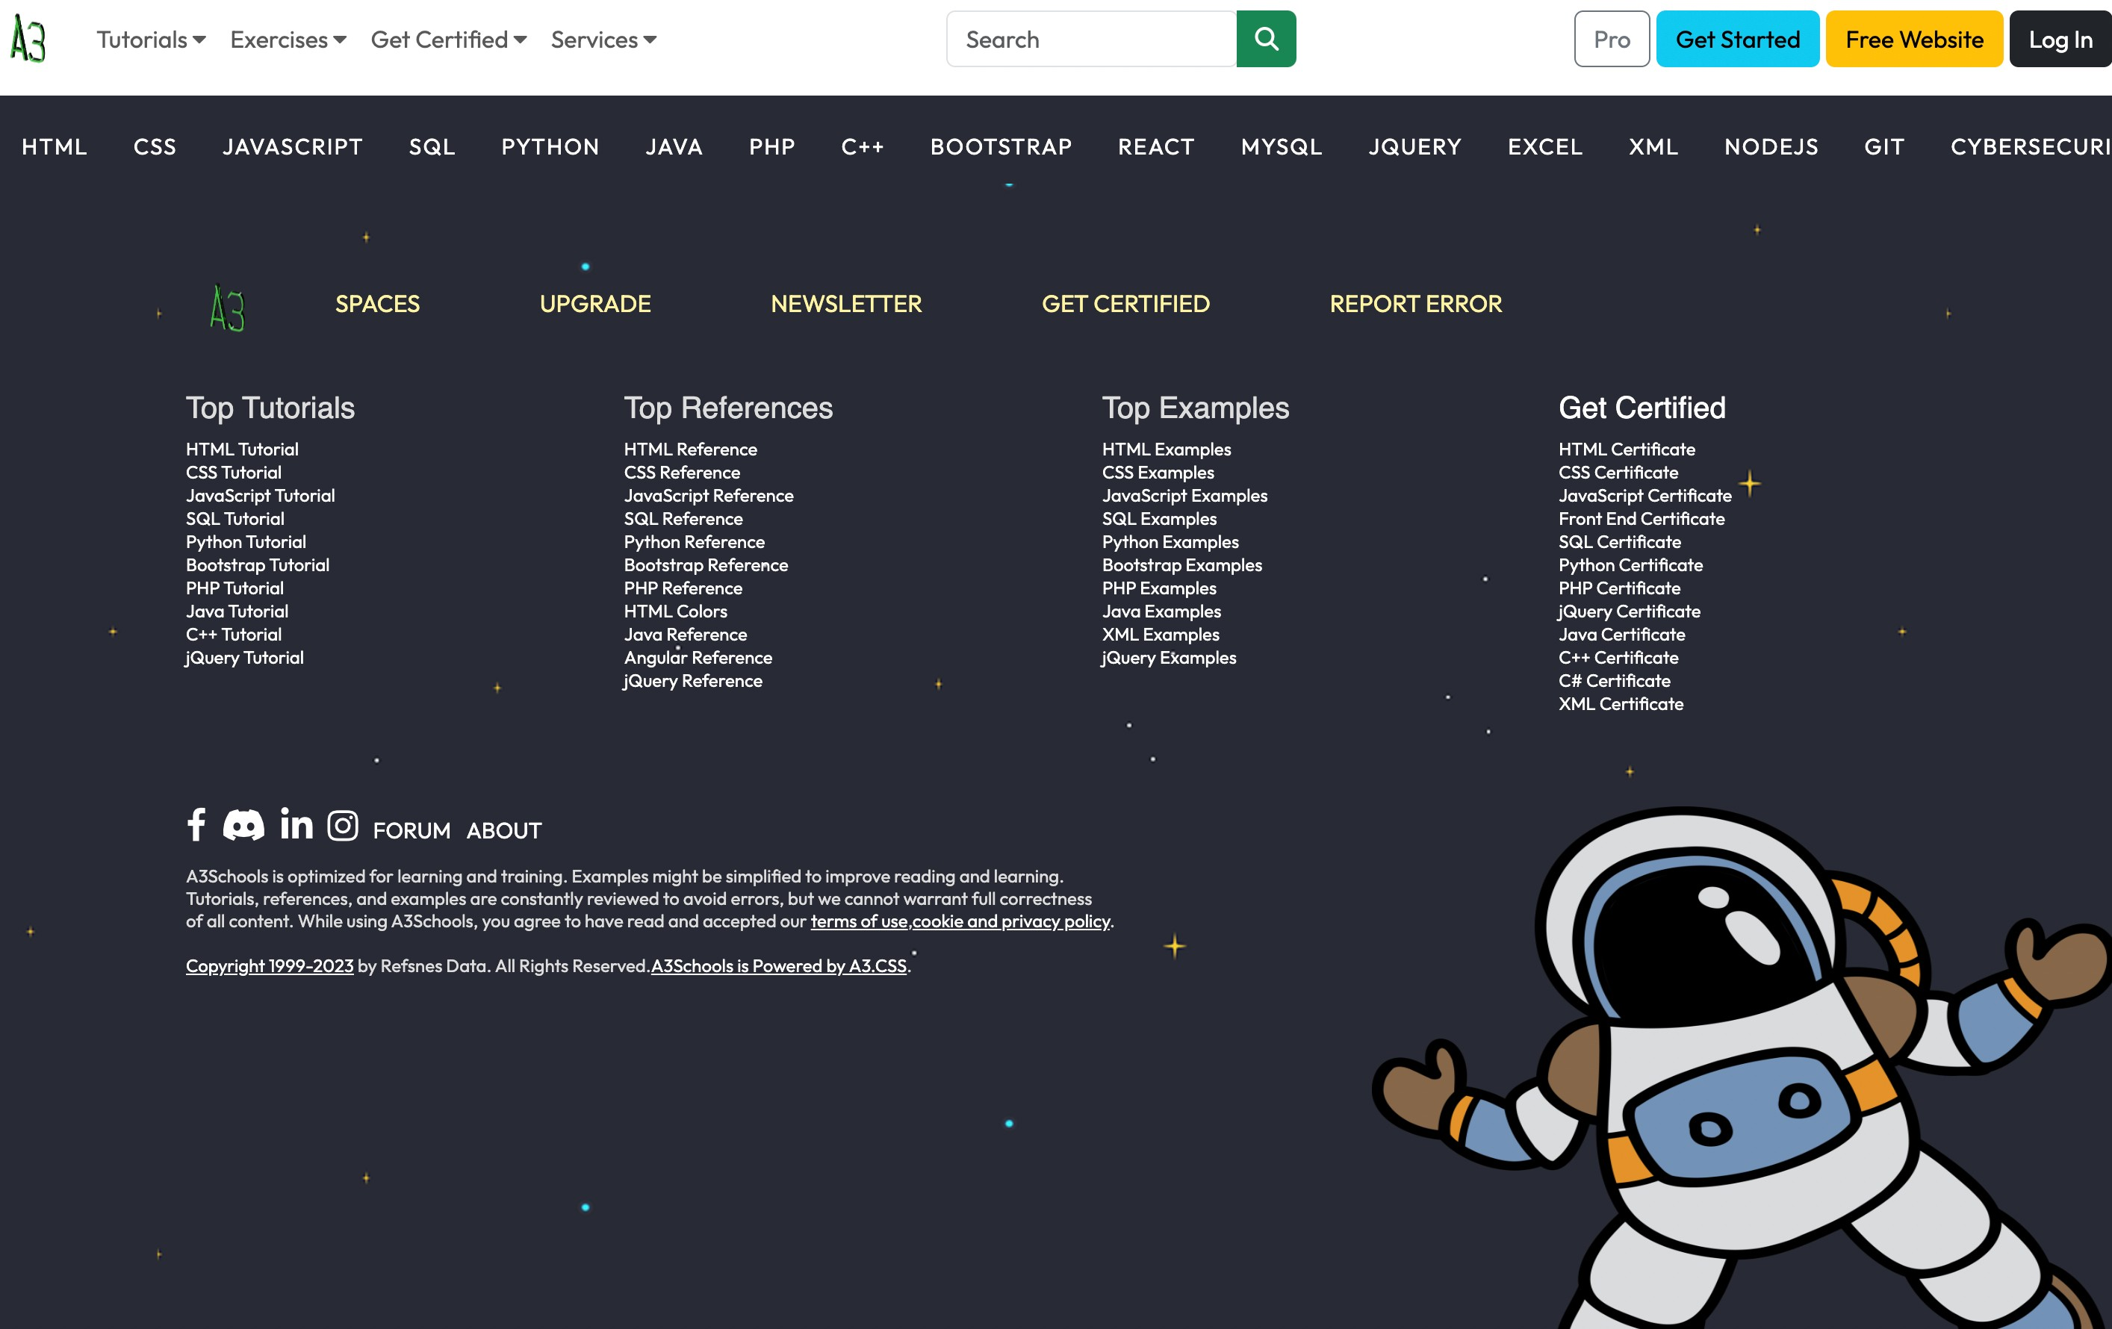
This is the card Section Where there is a direct link to the the tutorial of the language that the card is representing
I have made this component using react .
Then there is a footer section at the bottom of the website and the footer component is also present in every page of the tutorial

Slide 11
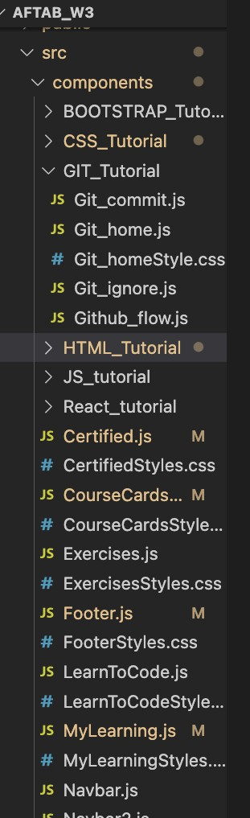
On the second Navbar there are the tutorial that this website offers Like Html ,Css ,Javascript ,Sql ,Python etc…..
I have made the component of different different pages :
I have divided the Tutorial pages using Grid I have divided the layout into two columns one for the content and I for the topic covered in the tutorial .

Slide 12
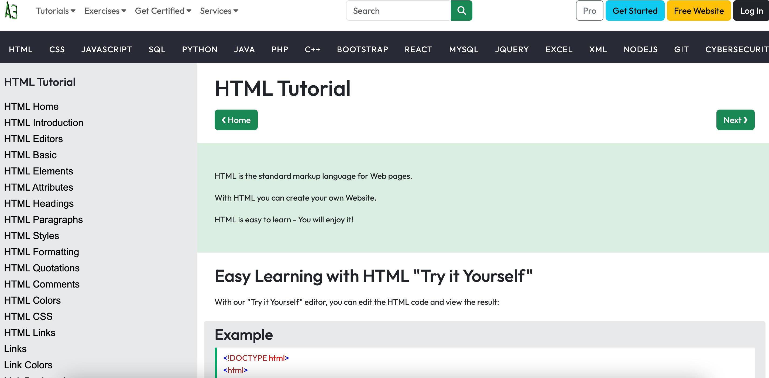
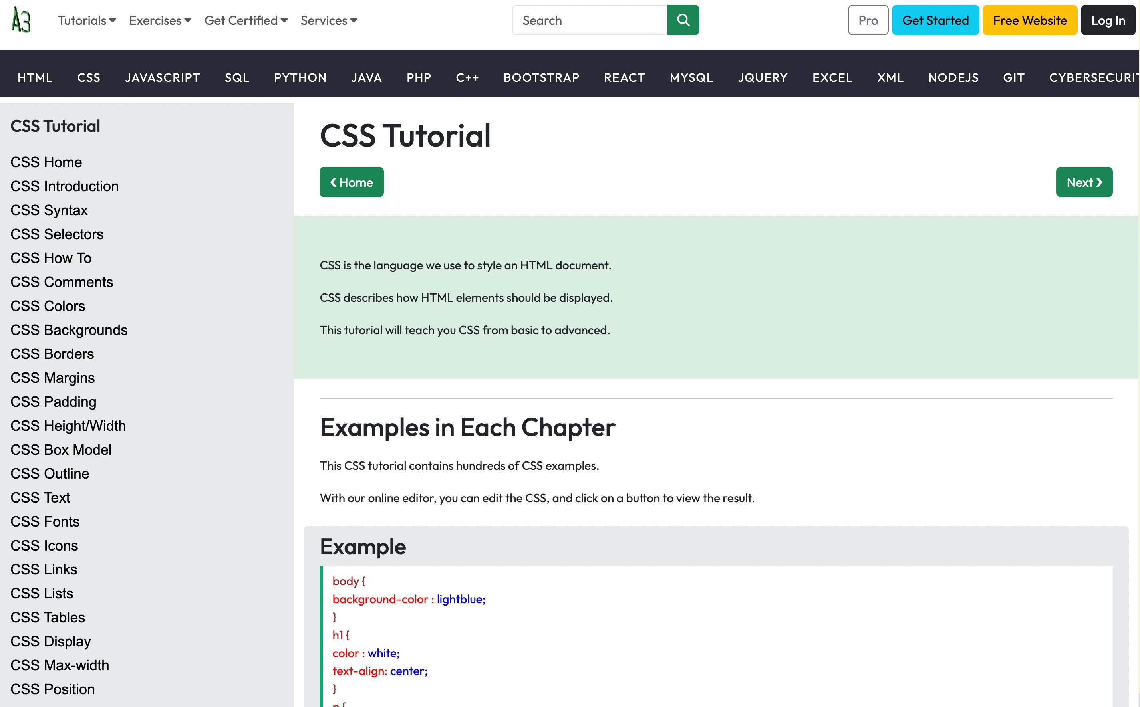
************************HTML Tutorial****************************
*********************************CSS Tutorial**************************

Slide 13
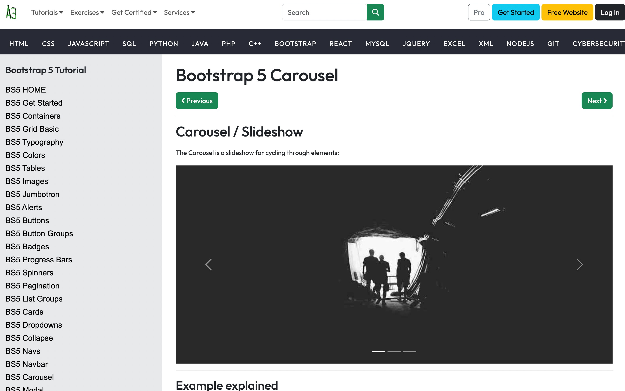
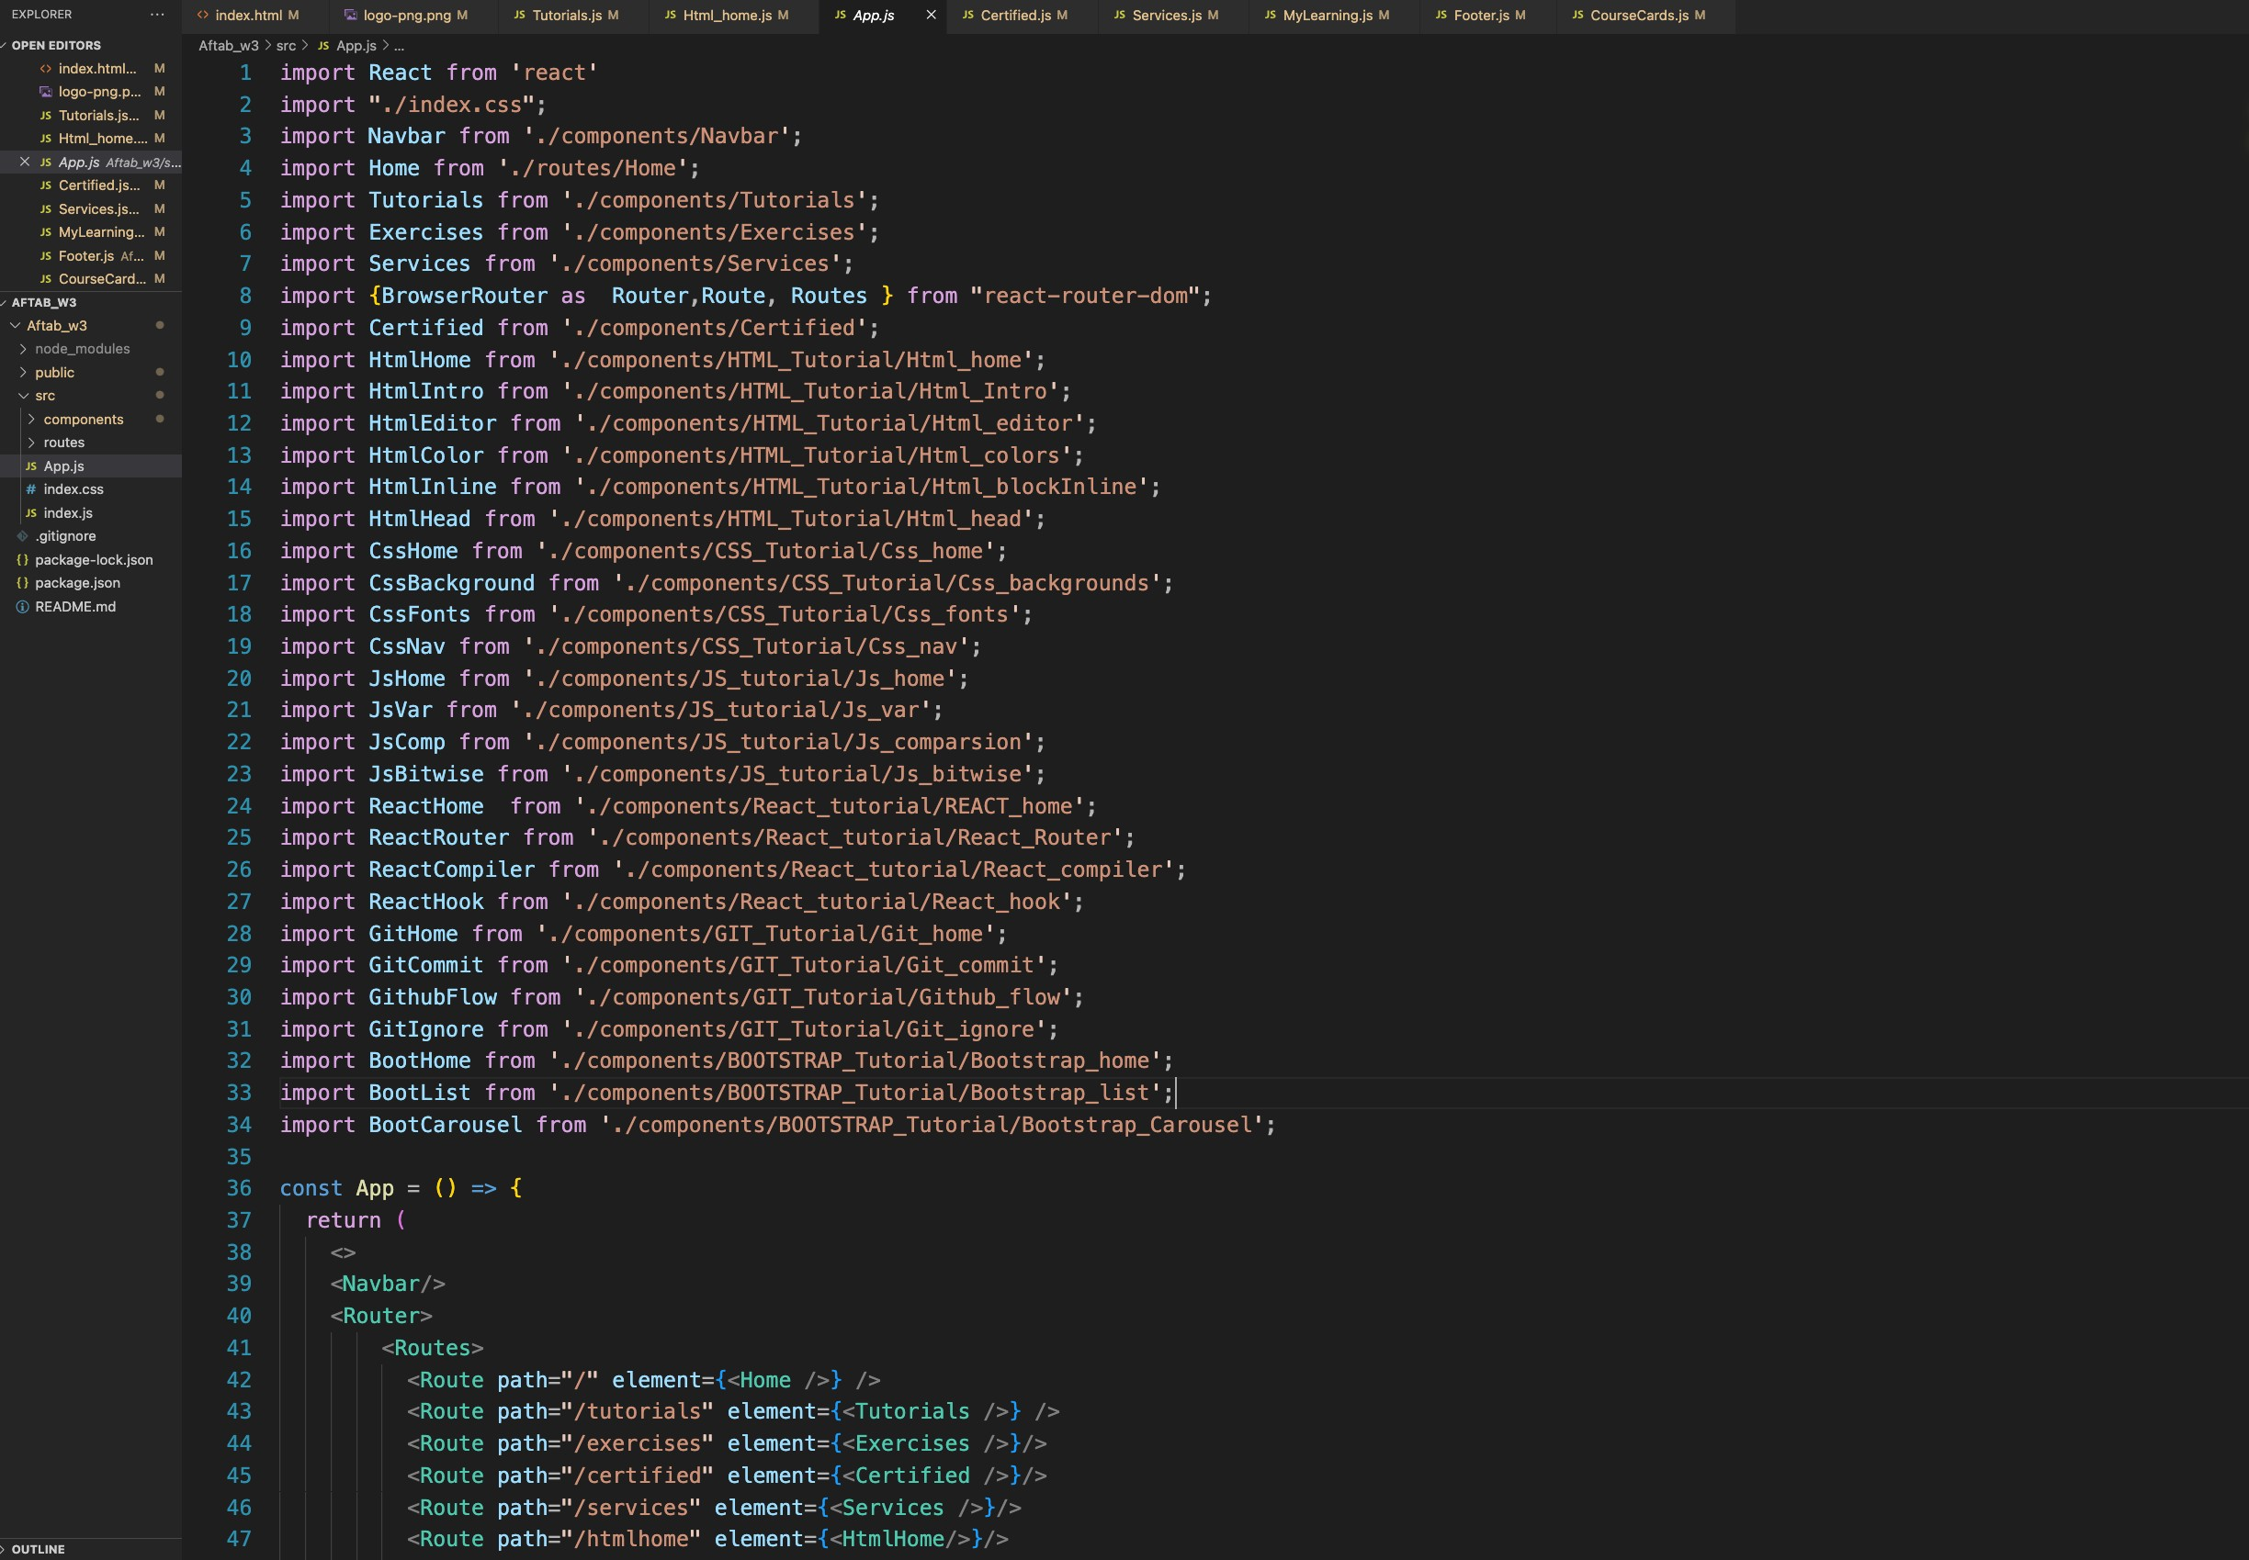
*******************************Bootstrap Tutorial******************************
This is the demo of how the tutorials looks like on this website ……… In the app.js the routing of the whole CMS is done like :

Slide 14
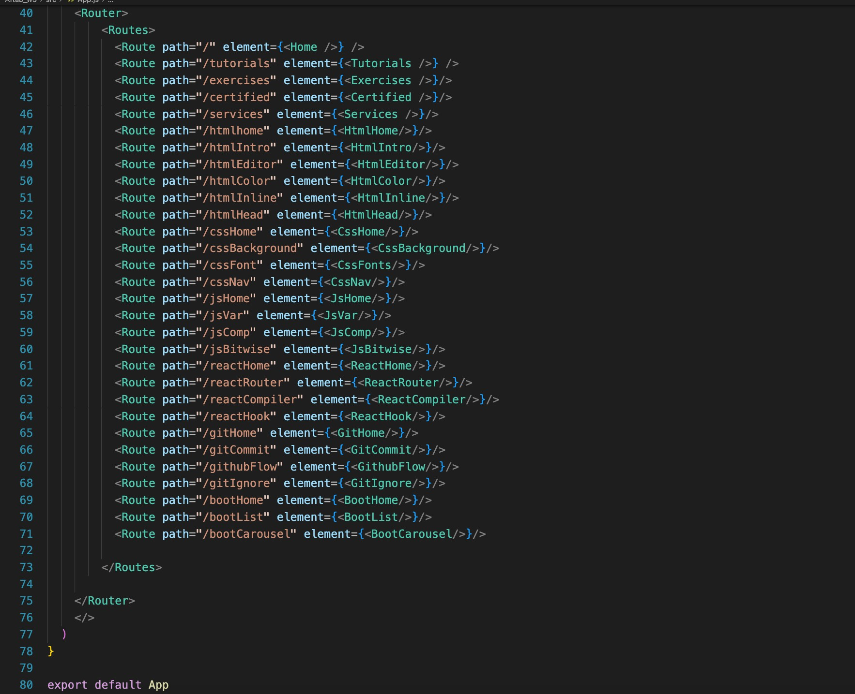
So This was the CMS made using react it ensures the content is of the highest quality, with expert-authored tutorials and interactive elements that encourage hands-on learning.
Whether you're a beginner aiming to grasp the fundamentals or an experienced programmer looking to expand your skills, this CMS offers a comprehensive and inclusive learning experience. It's your gateway to exploring, learning, and coding your way to success in the dynamic world of programming.

